Slide 1
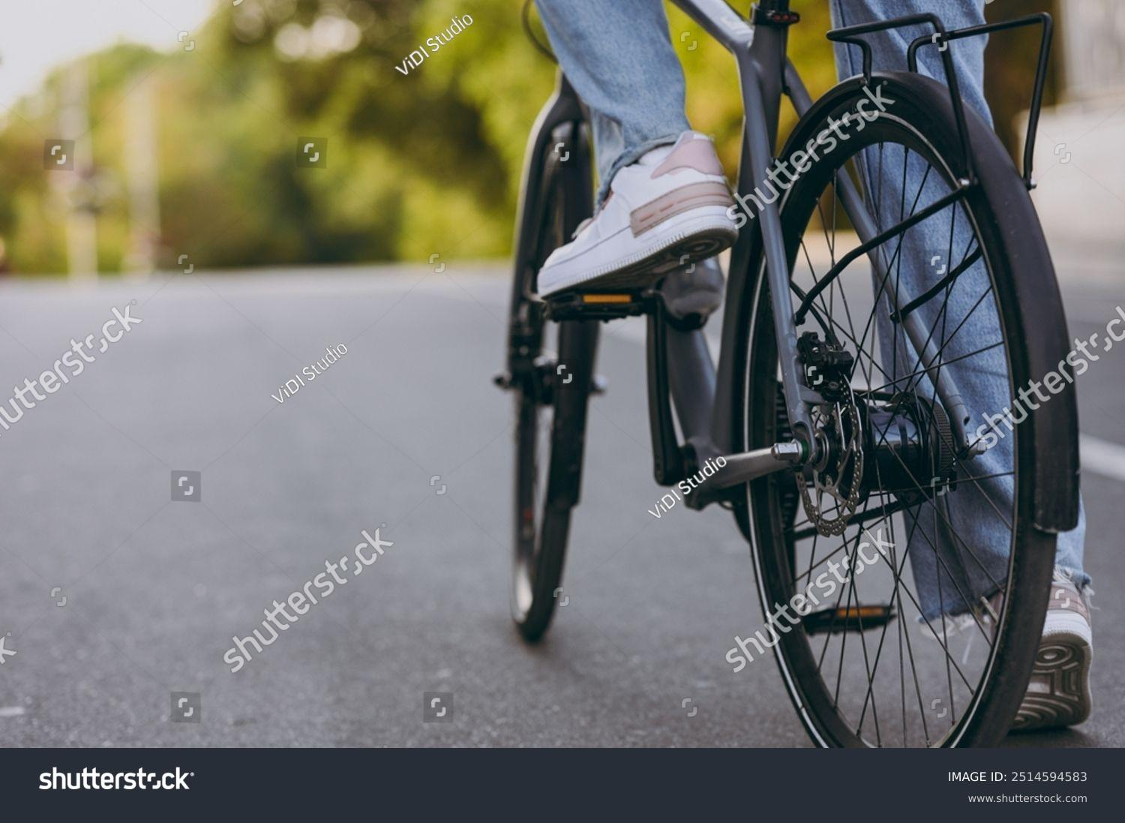
Cyclistic Case Study
How to increase cyclistic bike annual memberships?
June 23 , 2025
By:
AJAY SAI PHANEENDRA REDDY CHINNAM

Slide 2
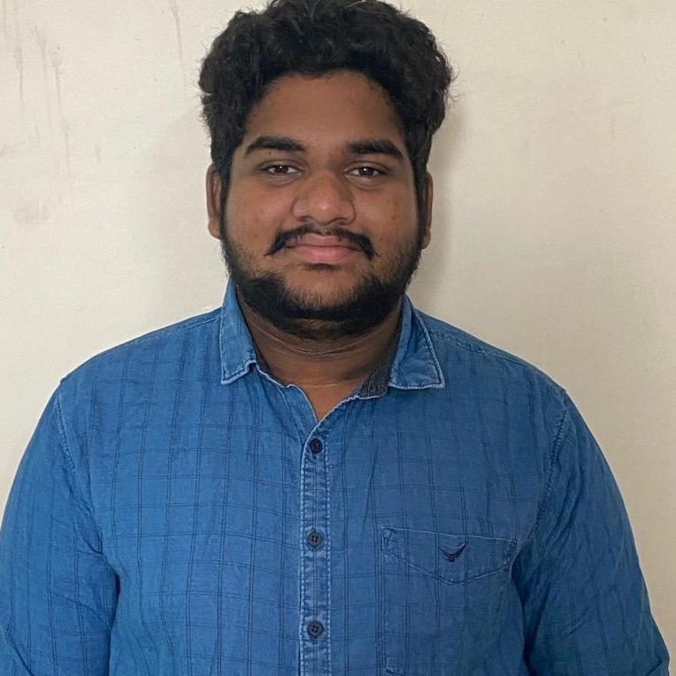
Hi!
I’m AJAY SAI PHANEENDRA REDDY CHINNAM
An Aspiring Data Analyst
Github:https://github.com/Ajay2003-prog/Cyclistic_Casestudy_2019-2020Q1.git

Slide 3
Business Objectives
1. How do annual members and casual riders use Cyclistic bikes differently?
2. Why would casual riders buy Cyclistic annual memberships?
3. How can Cyclistic use digital media to influence casual riders to become members?

Slide 4
Company Goal : How to increase annual memberships?
Tools Used:
Excel
R studio

Slide 5
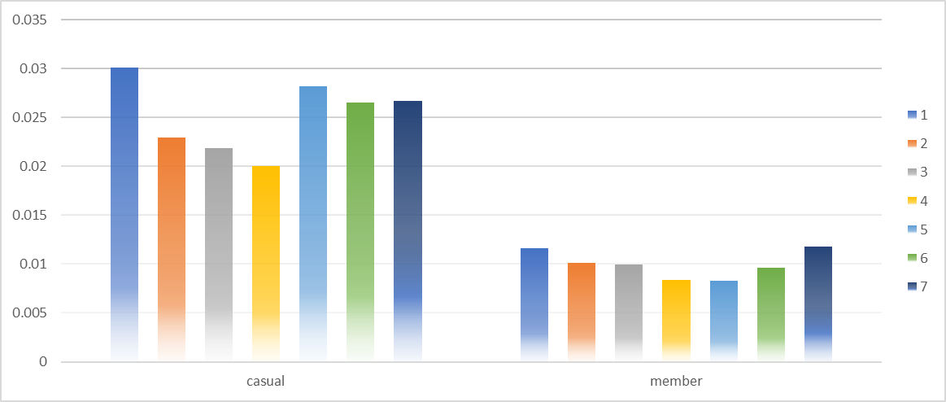
Ride Duration of each member/casual of 2019:

Slide 6
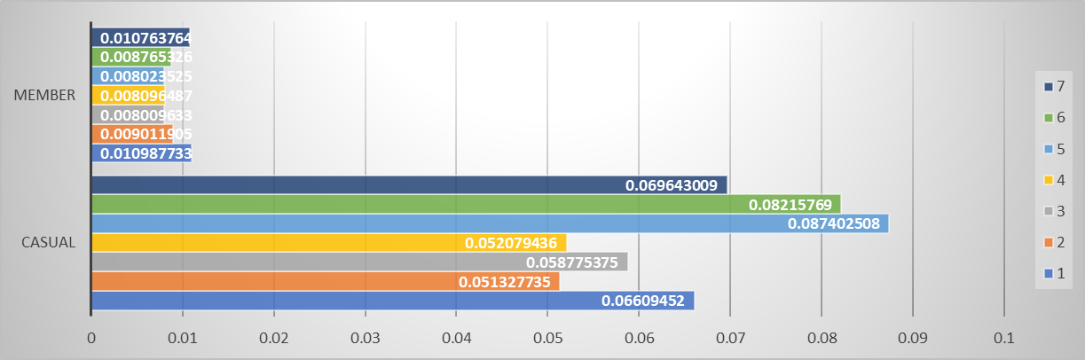
Ride duration of each member/casual of 2020:

Slide 7
By comparing both the data of 2019 and 2020Q1 the member/casual riders are riding differently
In both the data the highest cyclists are mostly the casual riders rather than the membership riders
Although they are different one thing is common between the both data.
Both membership and casual riders highly riding on the weekends.

Slide 8
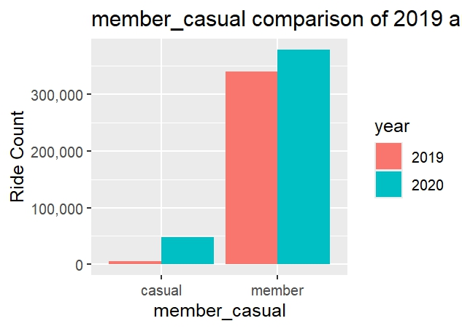
Comparing the data between 2019 & 2020 Q1 memberships by using R:

Slide 9
The graph shows that when compared to both the Q1 data the annual membership was high than the 2019 Q1
Reason: In 2019 there are some membership riders but when we take 2020 there is slightly higher than 2019 memberships.
While the casual riders take memberships it would some less amount than the casual ones. With some discount (or)coupons
Because not only job holders there are some factors like part time job holders,students they can’t afford full price
So that’s one of the reason we see slightly increase in memberships than the 2019 Q1.

Slide 10
Key Findings:
Mostly the riders using cyclistic bikes on weekends.
And also there is slightly increase in the annual memberships while comparing to the 2019Q1.

Slide 11
Conclusion:
Use podcasts to influence the casual riders to memberships.
Promote the Health Benefits such as what is the use of cyclistic ride.
Bill Boards also uses to influence the casual riders.
Offer coupons and some cash back offers
Use instagram to promote the memberships. Now a days it’s quite popular.
Mouth publicity from membership riders.

Slide 12


